Slide 1
Decode Java+DSA

Slide 2

Chapter 2 : Conditionals
If, If - Else
Multiple conditions - &&, ||
Nested if else
Else if
Ternary
Switch

Slide 3
IF - ELSE

Slide 4


Ques : Take positive integer input and tell if it is even or odd

Slide 5
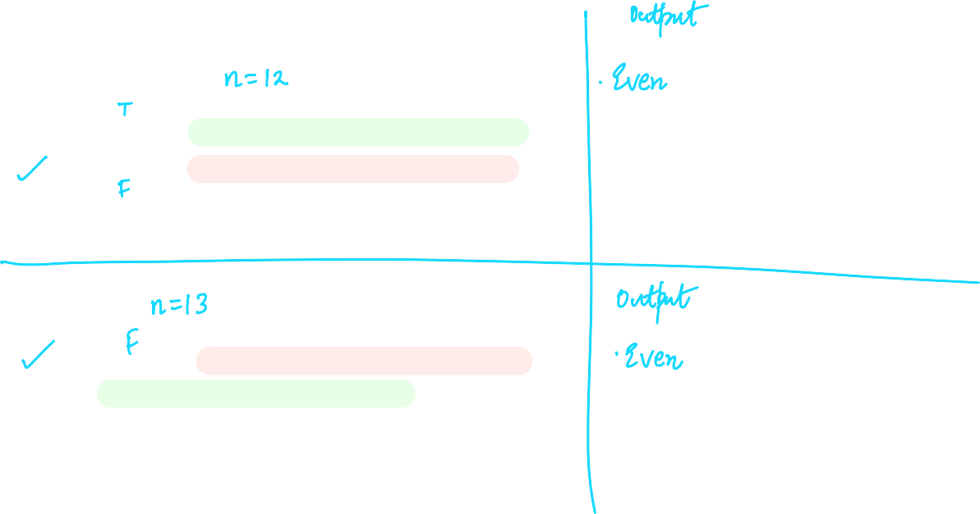

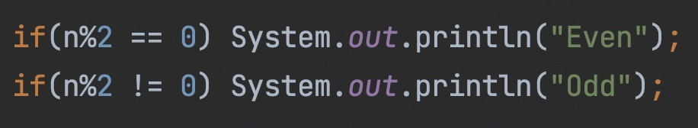
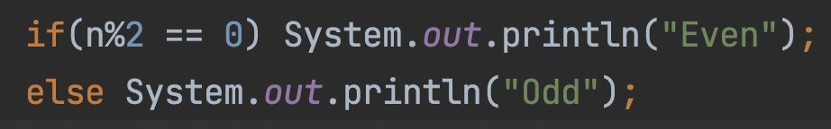

Slide 6







Slide 7







HW : Take positive integer input and tell if it is divisible by 5 or not.

Slide 8





Ques : Take integer input and print the absolute value of that integer

Slide 9






*Ques : If cost price and selling price of an item is input through the keyboard, write a program to determine whether the seller has made profit or incurred loss or no profit no loss. Also determine how much profit he made or loss he incurred.

Slide 10
HW : Given the length and breadth of a rectangle, write a program to find whether the area of the rectangle is greater than its perimeter.

Slide 11



Multiple Conditions Using && and ||

Slide 12


Ques : Take positive integer input and tell if it is a three digit number or not.

Slide 13
HW : Take positive integer input and tell if it is a five digit number or not.

Slide 14






Slide 15






Ques : Take positive integer input and tell if it is divisible by 5 or 3.

Slide 16



Ques : Take 3 numbers input and tell if they can be the sides of a triangle.

Slide 17








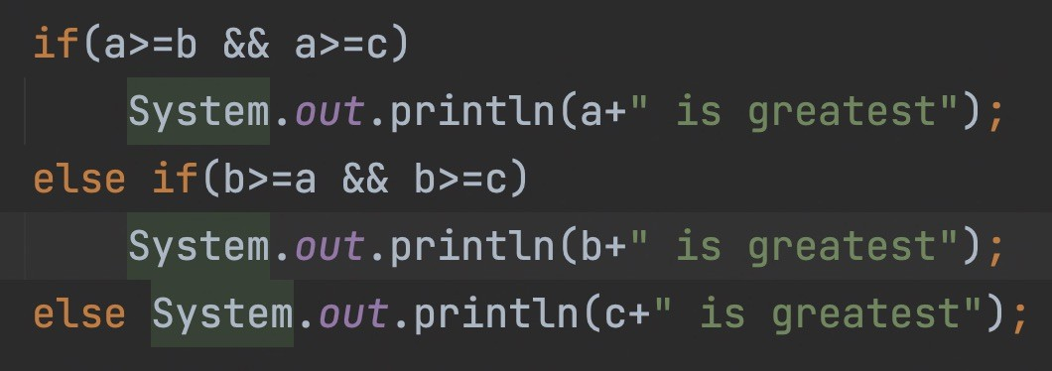
Ques : Take 3 positive integers input and print the greatest of them.

Slide 18

Ques : Take 3 positive integers input and print the greatest of them.

Slide 19
Ques : Take 3 positive integers input and print the greatest of them.

Slide 20
Homework : Take 3 positive integers input and print the least of them.

Slide 21
Nested If - Else

Slide 22










Ques : Take 3 positive integers input and print the greatest of them.

Slide 23



HW : If the ages of Ram, Shyam and Ajay are input through the keyboard, write a program to determine the youngest of the three.

Slide 24
Else If

Slide 25

Ques : Take input percentage of a student and print the Grade according to marks:
81-100 Very Good
61-80 Good
41-60 Average
<=40 Fail

Slide 26







HW : Given a point (x, y), write a program to find out if it lies in the 1st Quadrant, 2nd Quadrant, 3rd Quadrant, 4th Quadrant, on the x-axis, y-axis or at the origin, viz. (0, 0).

Slide 27













Ternary Operator
expression 1 ? expression 2 : expression 3

Slide 28


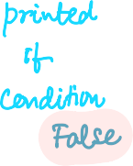

Slide 29




Switch Statement

Slide 30

switch ( integer expression ) { case constant 1 :
do this ;
case constant 2 : do this ;
case constant 3 : do this ;
default :
do this ;
}

Slide 31

Ques : Write a program to create a calculator that performs basic arithmetic operations (add, subtract, multiply and divide) using switch case and functions. The calculator should input two numbers and an operator from user.

Slide 32
MCQ Time !

Slide 33



Predict the output
psvm(String[] args ) {
int x = 10, y = 20 ; if ( x == y ) ;
System.out.print(x+” “+y);
}

Slide 34
HW : Predict the output
psvm( ) {
int x = 3, y = 5 ; if ( x == 3 )
System.out.print(x); else ;
System.out.print(y);
}

